Slide 1
TOPIC B2:
PROGRAMMING
LESSON B2-10
SEARCHING ALGORITHMS

Slide 2
AGENDA
Warm-up Question
Linear Search
Binary Search
NOTE!
Have a way to take notes and a way to write code available for this lesson

Slide 3

THE WARM UP QUESTION
Create algorithms for the following Big-O complexities:
O(n)
O(n²)
O(1)

Slide 4
THE WARM UP ANSWER
n = 10 #O(n) for i in range(n): print(i) #O(n^2) for i in range(n): for j in range(n): print(i, j) #O(1) print(n)

Slide 5
SEARCHING ALGORITHMS
Searching algorithms are used to find specific items in data structures
Some examples of this are:
Finding items in a database
Finding words in a document or webpage
Finding webpages in a search engine
For today, our goal is to find a specific item inside of a list

Slide 6
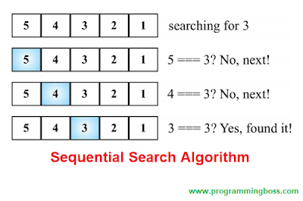
LINEAR SEARCH
The linear search, also known as the sequential search, is the most simple type of search
A linear search traverses the data structure from beginning to end, looking for a specific item
What’s the best case scenario for this algorithm?
What’s the worst case scenario for this algorithm?

Slide 7
LINEAR SEARCH
To implement a linear search using a list, we can use a for loop
We’ll also need a key variable, being the item we’re searching for
First, we compare the element stored at index 0 on the list to see if it matches
If the element at 0 is the same as the key, we return that we found the value in the list at location 0
If not, we check the next element until we get to the end of the list

Slide 8


LINEAR SEARCH
The code below is a simple linear search algorithm
What’s it’s Big-O complexity in terms of time? What about space?
nums = [3, 21, 0, 9, 4, 42, 49, 10] key = 9 position = -1 for i in range(0, len(nums)): if key == nums[i]: position = i if position != -1: print("element found at index ", position) else: print("element was not found")
Property of Will Stancil

Slide 9
BINARY SEARCH
Unfortunately, this linear search isn’t a particularly efficient algorithm
If you have a large dataset, it could take forever to run on
I mean, how many webpages are on Google? It would take forever to check all of those

Slide 10
BINARY SEARCH
So, we have the binary search
Binary search reduces the number of items to search by half every time, making it much more efficient
But, the downside, is that the list must be sorted

Slide 11
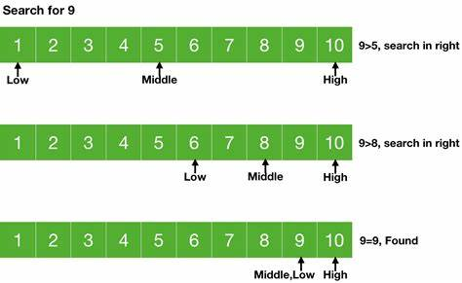
BINARY SEARCH
For the binary search we do need more variables
A variable called lower to store the lower boundary index
A variable called upper to store the higher boundary index
A variable called mid that stores the result of (lower + upper)//2

Slide 12
BINARY SEARCH
The algorithm is as follows:
Compare the value at the mid index to the key
If that value is the key, you can return the index
But, if it’s not:
If the value is smaller than the key, we can disregard the left half of the list, changing the lower variable to mid + 1
If the value is larger than the key, we can disregard the right half of the list, changing the upper variable to mid – 1
We then rinse and repeat until the value is the key, or the upper and lower values are the same, and then we return -1

Slide 13
BINARY SEARCH
The code below is a simple binary search algorithm
What’s it’s Big-O complexity in terms of time? What about space?
nums = [2, 5, 9, 11, 15, 19, 20, 23, 27, 29, 30, 31, 34, 36] key = 11 found = False lower = 0 upper = len(nums) mid = 0 while lower <= upper and found == False: mid = int((lower+ upper)/2) if nums[mid] == key: found = True elif nums[mid] < key: lower = mid + 1 else: upper = mid - 1 if found: print('The value was found at index', mid) else: print("The value was not found")

Slide 14
BINARY SEARCH
What’s the worst case for this algorithm? What about the best case for this algorithm?
nums = [2, 5, 9, 11, 15, 19, 20, 23, 27, 29, 30, 31, 34, 36] key = 11 found = False lower = 0 upper = len(nums) mid = 0 while lower <= upper and found == False: mid = int((lower+ upper)/2) if nums[mid] == key: found = True elif nums[mid] < key: lower = mid + 1 else: upper = mid - 1 if found: print('The value was found at index', mid) else: print("The value was not found")

Slide 15
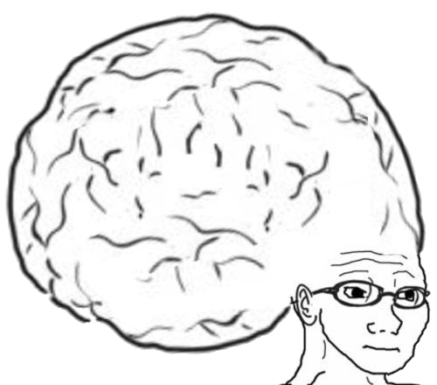
VOCAB TO REMEMBER
Searching Algorithm
Linear Search
Sequential Search

Slide 16
LAB
Now, from memory, try and recreate both the sequential and binary search algorithms

